Slide 1
53rd Weather Reconnaissance Squadron 2012 Hurricane Season – Ops Review
Lt Col Jon Talbot
Tropical Cyclone Research Forum
I n t e g r i t y - S e r v i c e - E x c e l l e n c e
Notes:
1
1
1
1
1
1
1
1
1
1
1
1
1
1
1
1

Slide 2
Season Comparison For Tasking
’08 ’09 ’10 ’11 ‘12
TASKED 244 104 232 191 162
CANCELLED 60 44 85 59 36
REQUIRED 184 60 147 132 126
ACCOMP 183 59 142 130 125
RELIABILITY 99% 98% 97% 99% 99%
I n t e g r i t y - S e r v i c e - E x c e l l e n c e
Notes:
1
1
1
1
1
1
1
1
1
1
1
1
1
1
1
1
Numbers are the lowest in 6 years! Still I good rate of reliability.
Hurricane numbers may be way down but winter storm reconn will not be!

Slide 3
NHOP Flight Hours
H
O
U
R
S
Notes:
6
Our average flying hours (including deploy and redeploy, Atlantic and Pacific) over the last 8 years is 900 hours and is —indicated by the red line.
In 2011 our flying total was 971 (only 764 storm but 207 in support and Deploy/Redeploy Hours) That is 21% off all flying time was actually support flying!!
PLEASE SEE DUTTON FOR DATA ERRORS AND EXTRA INFO.

Slide 4
53rd Flying Hrs by Month
Notes:
4
4
4
4
4
4
4
4
4
4
4
4
4
4
4
4
40 percent of your flying done in August! Sep comes in second with 31%.

Slide 5
Hours of Flying Hours by Storm
Notes:
IRENE garnered 24% of the business. RINA and EMILY grabbed another 26% of the total.
13% of hours this year spent in the Pacific.

Slide 6
Luck is part of the Game

Slide 7
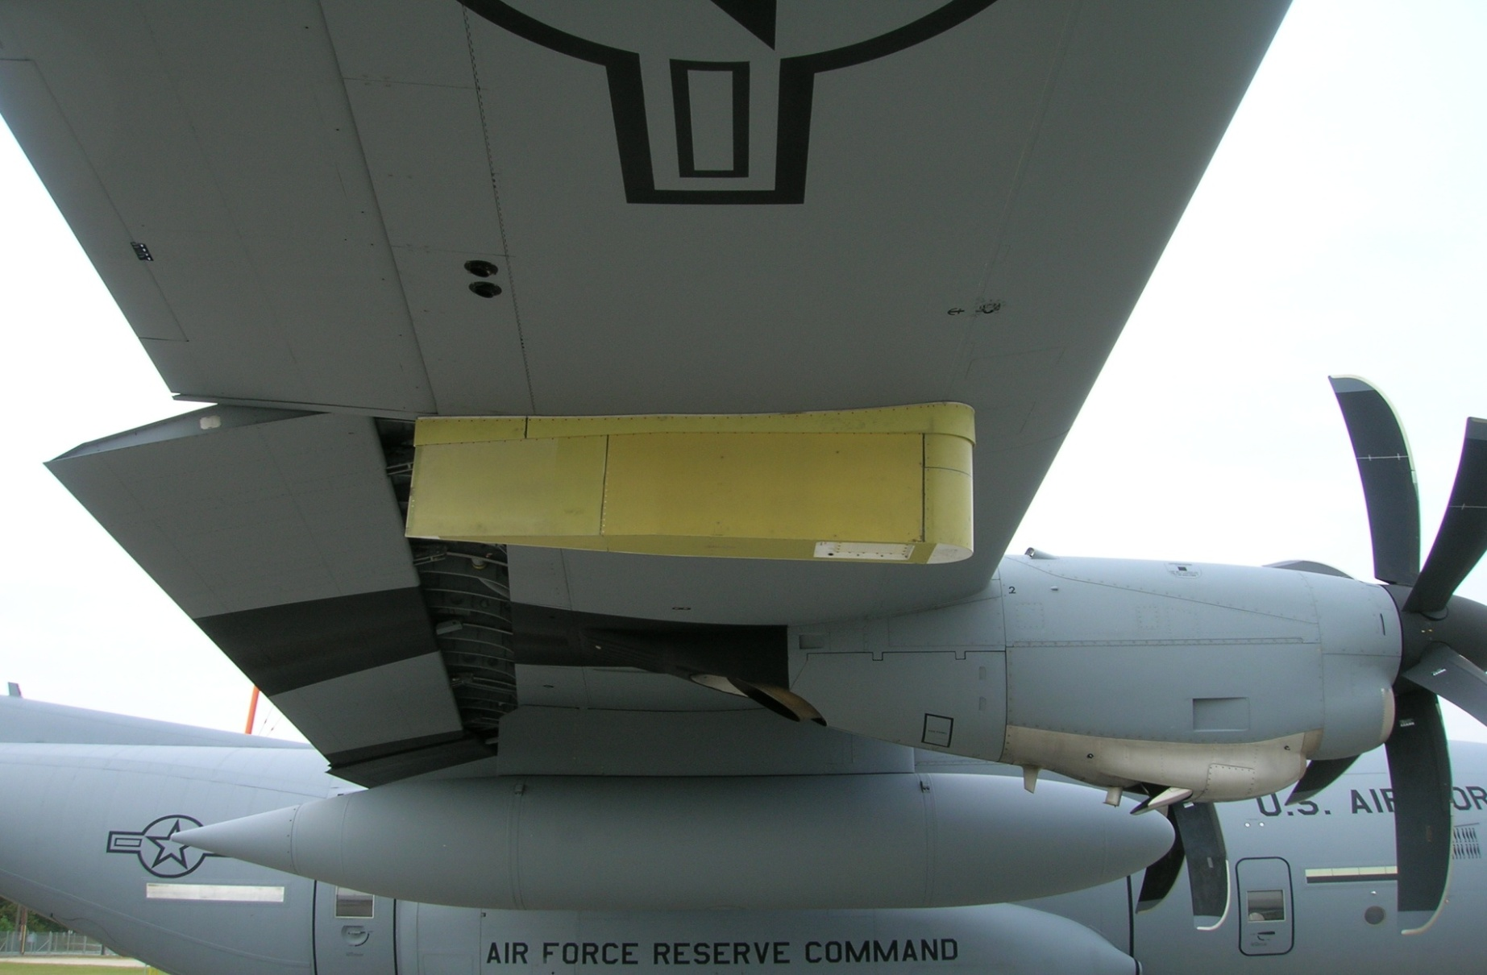
Technological Improvements
Software Upgrade—Spring 2013
SFMR
-operator training
-In-house Calibrations
- Need better light wind/rain algorithm
Dropsondes
-Aspen v3.1—Spring 2012
-intermittent auto shutdown prob
-Windows 7 bios issue; solved
Sat-phone Upgrade
-Initial capability—Fall 2013
Notes:
NEED TO UPDATE THIS ONE
J-Model Satellite Ground Station/Aircraft Software Upgrade: Latest software upgrade in Jun 10
AVAPS (Airborne Vertical Atmospheric Profiling System): Latest AVAPS software upgrade was in Jun 10. Sonde upgrade: Jun
SFMR: 3rd operational season, new antenna. Water leakage problem on 0.0% of misssions with heavy rain. Discovered mid season. Fixed late season. Software fix late season, installed Sep 09. Good results in IDA.

Slide 8
AXBT’s
Started 3yr test program 2011 Season
Current launch system marginal but usable at 10Kft or below
Navy provided data operators and portable receivers
Expect operations to continue 2013
Utility for hurricane operational models will be determined after 2013 season

Slide 9
AXBT Launcher

Slide 10
Bouys loaded

Slide 11
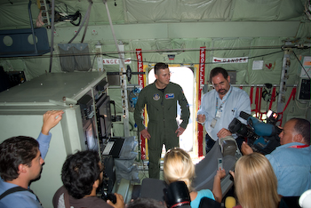
Public Affairs
-In-House Static Displays
-School Visits
-Media Flights
-Aero India
-CHAT
www.hurricanehunters.com
Notes:
Update with photo
The 53rd continues to run an active public affairs program.
1. Media Flights: resumed in the 2006 storm season.
2. Airshows/Statics: Dubai was the highlight (Probably can get numbers for these if you think we need them?)
3. CHAT: Caribbean Hurricane Awareness Tour (late March 2012—our busiest event and most important). OG Commander went last year and this year going to tie in humanitarian support.
Website: Hurricanehunters.com no an official “mil” page. Continues to be a valuable source of information.

Slide 12
U.S. AIR FORCE RESERVE
Notes:
Update question comment slide!!

